Slide 1
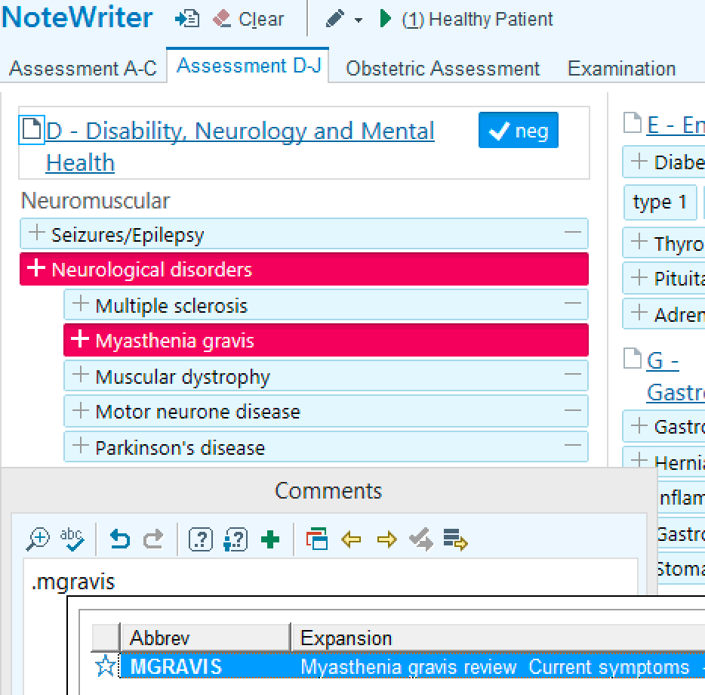
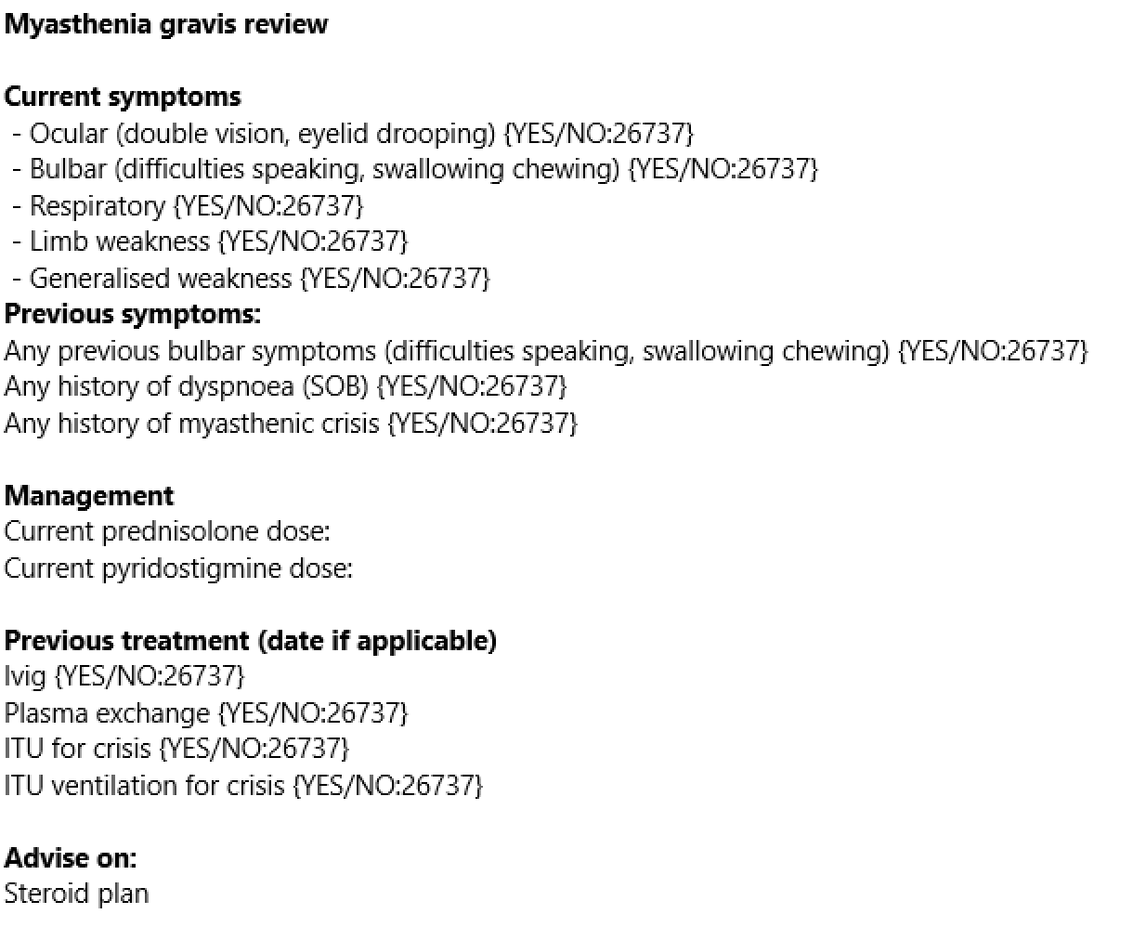
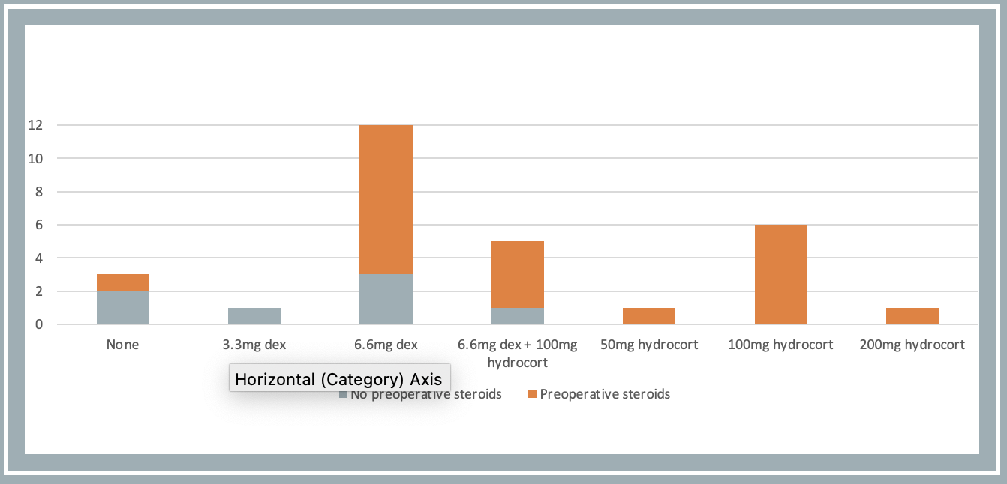
DIGITAL TRANSFORMATION OF PREASSESSMENT PATHWAY FOR PATIENTS WITH MYASTHENIA GRAVIS UNDERGOING THYMECTOMY
Dr Olivia Rose Beesley, Mr Davide Patrini, Dr Ruth Hurley, Dr Emilie Martinoni Hoogenboom
Figure one: Screen shot of preassessment for MG & insertion of smartphrase
Figure two: Smartphrase for MG preassessment ‘mgravis’
AIM
INTERVENTION
To standardize the preassessment and ensure adequate perioperative steroid replacement for patients with Myasthenia Gravis (MG) undergoing thymectomy and identify those with clinical features predictive of postoperative myasthenic crisis (POMC).
Smart phrases are blocks of text that can be copied and pasted into the hospital's electronic health records system. We created a specific smart phrase to facilitate the assessment of patients with MG undergoing thymectomy. This digital tool allowed identification of any risk factors predictive of POMC and the need for a perioperative steroid treatment plan.
This process required early engagement with all stakeholders, including the neurology team, to indicate symptoms predictive of crisis. Our initial findings were shared with the thoracic surgeons and input was welcomed from the wider perioperative team. Thoracic preassessment and specialist nurses, who lead our thoracic preassessment service, were engaged in the entire process. Assessment is now standardised and any particular issue can easily be highlighted to the anaesthetic consultant.
BACKGROUND
MG is a rare autoimmune disease causing skeletal muscle weakness. Medical treatment include pyridostigmine and prednisolone. Thymectomy can be an effective treatment and leads to a reduction in the severity of weakness and the need for medication. The perioperative care of patients undergoing this procedure, including medication and steroid replacement is complex. POMC is a rare but life-threatening condition, characterised by rapidly worsening MG with potential respiratory and bulbar dysfunction. Several preoperative features have been identified as potential predictors of POMC¹.
In our centre, a thymectomy for MG is performed every four-six weeks, accounting for 1 in 5 mediastinal mass resections. The retrospective evaluation of the perioperative care for this group of patients uncovered a wide range of symptoms and medication regimes. We identified a significant variation in the approach to risk assessment and prediction of these patients and perioperative steroid prescribing.
Graph one: frequency of differing intraoperative steroid administration for patient with MG undergoing thymectomy
CLINICAL IMPLICATION
Standardisation of healthcare and clinical practice can improve quality, outcomes and accountability. This may be of particular relevance when caring for patients undergoing high risk procedures with more rare diseases, such as MG. The use of smart phrases provides a useful tool to identifying patients at higher risk of complications as well as highlighting the need for additional personalised care and destination planning. Evaluation of the transformation was through a series of stakeholders engagement meetings and qualitive feedback. The success of an intervention lies with adequate engagement of the targeted end user.
References: 1. Xue L, et al. Eur J Cardiothorac Surg 2017; 52: 692-697

